Slide 1
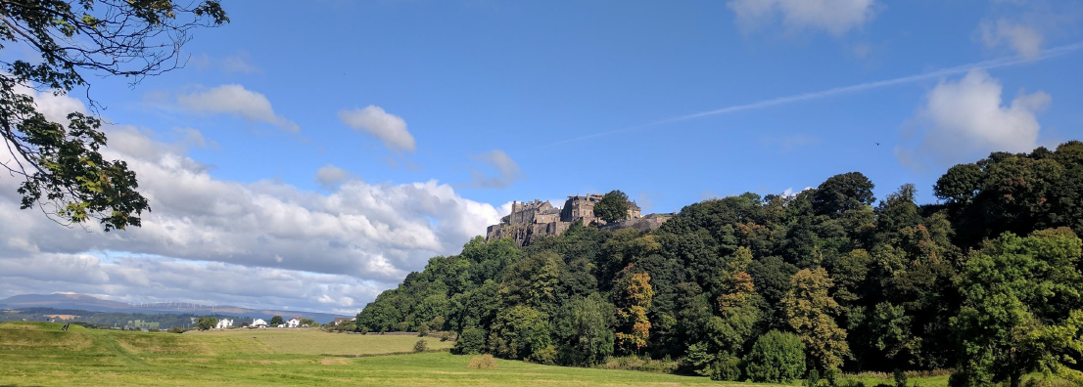


LDP3 Consultation: Call for Sites & Ideas
Information Session
19 August 2025
Planning & Building Standards, Stirling Council.

Slide 2
Agenda
  Local Development Plan 3 – Programme Overview
  Proposed Plan - Programme Overview
  Communities and Local Place Plans
  Call for Sites & Ideas Consultation - Approach, Requirements & Resources
  Next Steps
  Questions
Planning & Building Standards, Stirling Council.

Slide 3
1. Local Development Plan 3 Programme Overview
June 2023
Development Plan Scheme
2023-2024
Evidence Report
2025-2027
Proposed Plan Preparation
2025
‘Gate Check’ Assessment
2028
Proposed Plan Examination
2028
LDP3 Adoption
Planning & Building Standards, Stirling Council.

Slide 4



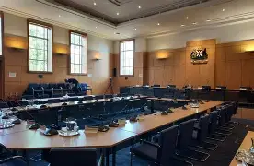
2. Proposed Plan – Programme Overview
  Stage 1 - Proposed Plan Preparation (Plan-Making Stage)
  ‘Call for Sites & Ideas’ Consultation – August to October 2025 (12 weeks)
  Allowing interest parties to submit ideas or sites they would like to be considered for inclusion in LDP3
  Submission deadline for Local Place Plans aligned to anticipated close of consultation period: 31 Oct 2025
  ‘Strategy & Site Options’ Consultation & Engagement – February to May 2026 (12 weeks)
  Public consultation on site options from LPPs and ‘Call for Sites’ submissions, and supported by community engagement events (in-person)
  Views will also be invited on the options/proposals identified through the spatial strategy review
  Preparation of Proposed Plan (Consultative Version) – May to October 2026
  Initiation of the site appraisal process, in line with the approved site appraisal methodology and guided by proposed spatial strategy
  Decision by Council to Approve the Proposed Plan for Consultation – December 2026
  Including an explanatory report detailing how LPPs, and other submissions, have been taken into account

Slide 5
3. Proposed Plan – Programme Overview
    Stage 2 - Proposed Plan Consultation and Modification:
    Consultation & Engagement on Proposed Plan – February to May 2027 (12 weeks)
    Public consultation on the content of the Proposed Plan, supported by community engagement events
    Decision by Council to approve the finalised Proposed Plan, modified or not, for adoption, subject to Examination – December 2027
Planning & Building Standards, Stirling Council.

Slide 6
4. Communities and Local Place Plans
Community involvement : Communities are actively encouraged to participate throughout the process. This could be as part of an organisation, group or individually.
Format of engagement: We will be arranging in person sessions to get views on the strategy and options submitted.
Local Place Plans: Communities are welcome to submit to the Call for sites & ideas as well as submitting a Local Place Plan. However, anything submitted as part of a Local Place Plan will be considered anyway so no need to double work.
Planning & Building Standards, Stirling Council.

Slide 7
4. Call for Sites & Ideas Consultation - Approach, Requirements & Resources
Approach: Call for sites and ideas via online platform.
Requirements: Completion of questionnaire - including series of set questions.
Resources: Supported by related GIS mapping data and tools, and links to relevant Topic Papers
Planning & Building Standards, Stirling Council.

Slide 8
4. Call for Sites & Ideas Consultation - Approach, Requirements & Resources
Structure of Questionnaire Form
1 – Promotor Information
2 – Site or Idea
3 – Proposed LDP Allocation: Site Information
4 – Proposed LDP Allocation: Development Information
5 – Proposed LDP Allocation: Development Opportunities & Challenges
6 – Proposed LDP Allocation: Engagement to date
7 – Proposed LDP Allocation: Site Deliverability & Development Viability
8 – Suggested Planning Policy or Proposal
9 – Suggested LDP Idea/Aspiration
Proposed Site Allocation
(Sections 3-7)
Planning & Building Standards, Stirling Council.

Slide 9
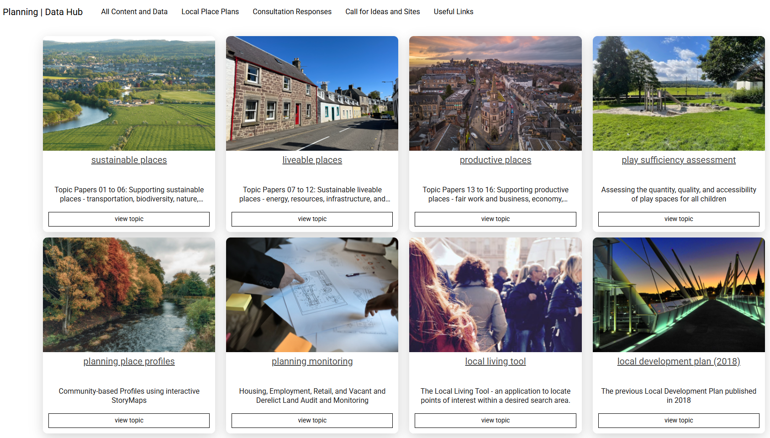
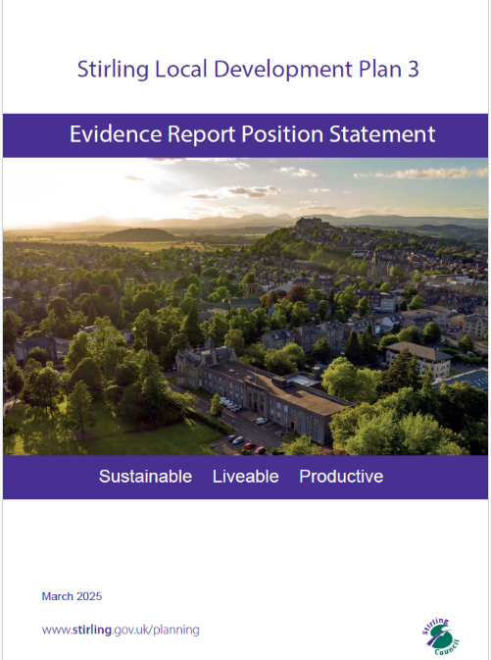
3. Call for Sites & Ideas Consultation - Approach, Requirements & Resources
Resources
GIS data: Supporting completing relevant questions
Mapping Tool: To aid drawing proposed site extent, boundaries, and size on O.S. base.
‘Scratch Pad’: Allows user to explore information relevant to proposed potential site, prior to form completion.
Evidence Report Topic Papers: Links to background information which may support responses
Planning & Building Standards, Stirling Council.

Slide 10
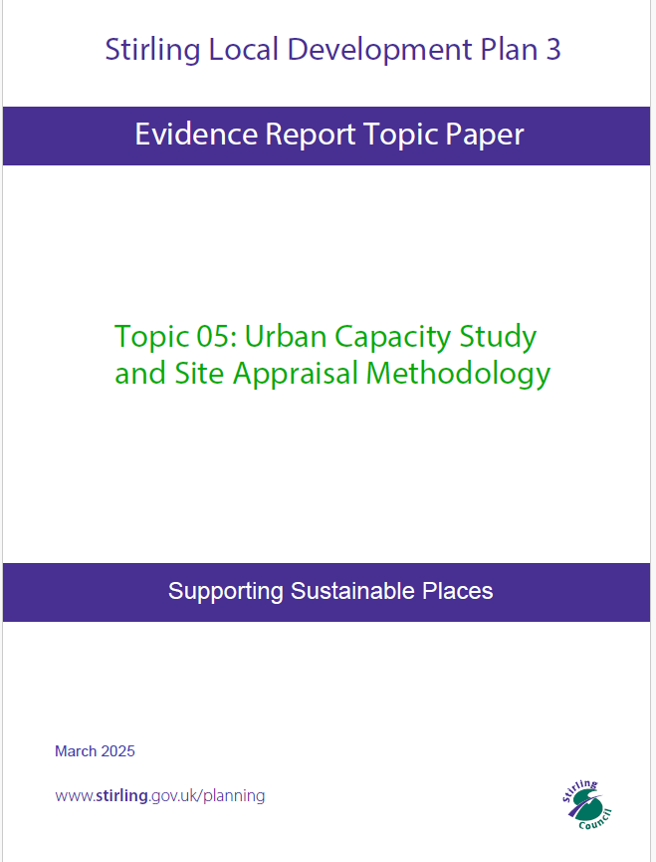
4. Call for Sites & Ideas Consultation - Approach, Requirements & Resources
Purpose/Next Stages
To provide information for the site appraisal process (future Plan phase)
Site Appraisal Methodology was consulted upon and formed part of Evidence Report - considered sufficient.
Staged Approach to appraisal:
  (i) High Level Initial Sift
  (ii) Assessment Against National & Local Objectives (including emerging Spatial Strategy)
  (iii) Detailed Site Assessment
Planning & Building Standards, Stirling Council.

Slide 11
5. Next Steps
Now – Launch of Call for Ideas and Sites consultation
28 August – Approval of the updated Development Plan Scheme and revised Participation Statement by ENTZ.
31 October – Close of Call for Ideas and Sites consultation, and deadline for submitting Local Place Plans for registration within the current Local Development Plan cycle
Planning & Building Standards, Stirling Council.

Slide 12

5. Questions
Planning & Building Standards, Stirling Council.

